Slide 1

Tower Defense

Slide 2








Step 0: What Entities do we need?
Tower
TowerBase
Enemy
Projectiles fired from Tower
Everything to be placed on a Tiled Map!
Map has paths that enemies can walk on
Notes:
Create entitytype enum

Slide 3
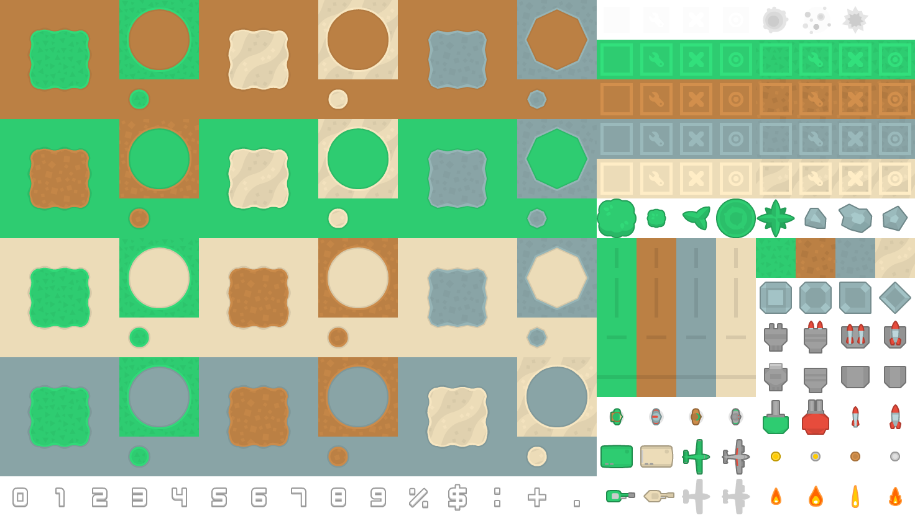
Step 1: Creating a Tiled Map

Slide 4
Step 2: Creating a TowerSelectionBox

Slide 5

TowerSelectionBox
A box needs:
A list of towers
Each tower needs:
Name, image, cost, etc

Slide 6
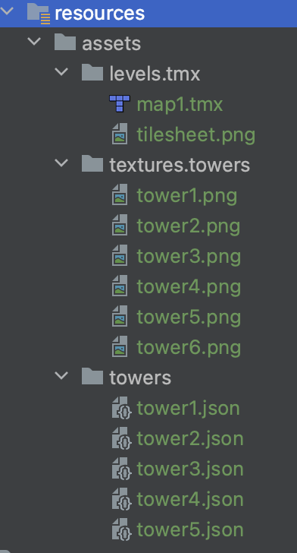
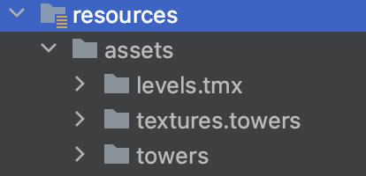
Assets required

Slide 7
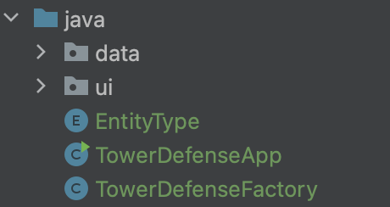
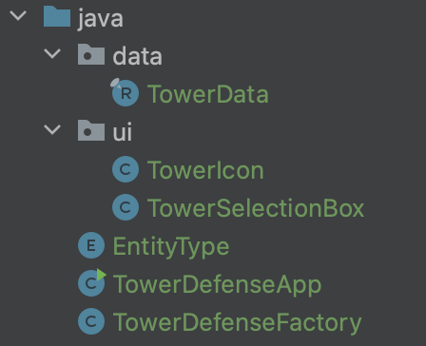
Java files required

Slide 8
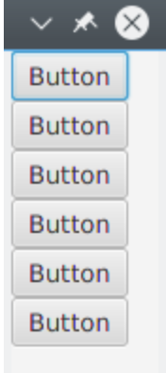
HBox vs VBox
Both layout their children in a singe line
HBox: one single horizontal row from left to right
VBox: one single vertical column from top to bottom

Slide 9
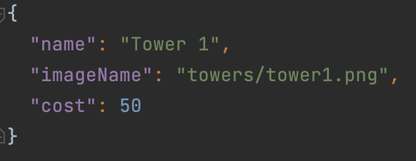
What is JSON?
An easy-to-understand format for storing and moving data
Data is in name-value pairs
Data is separated by commas

Slide 10
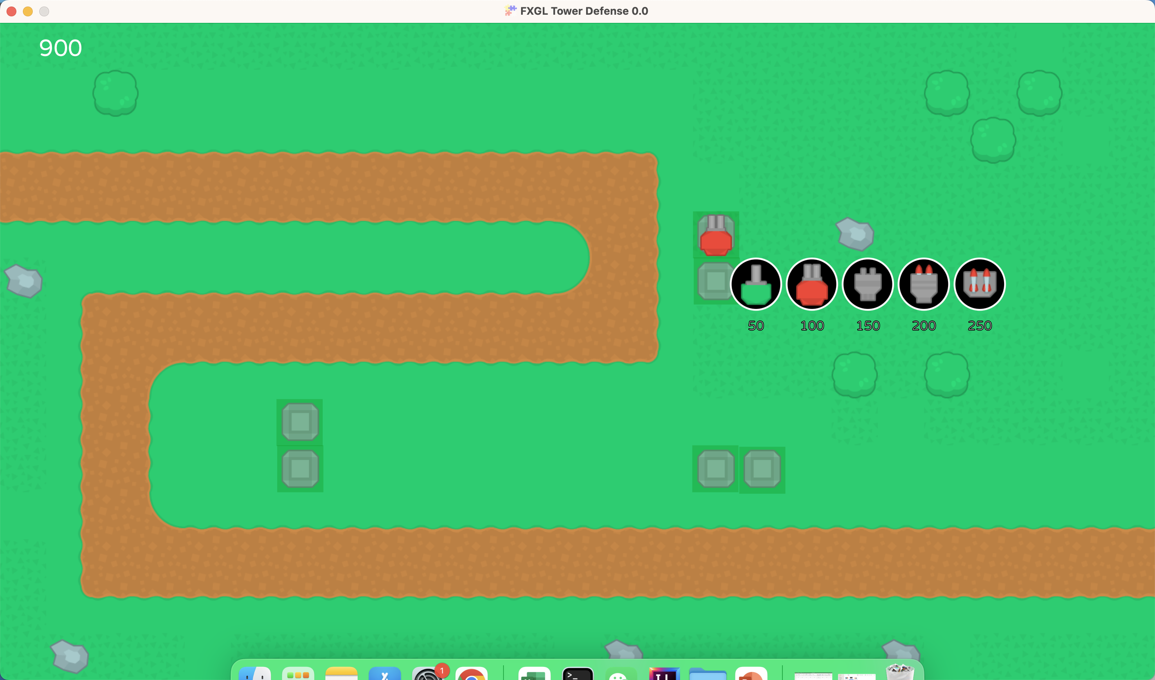
Cell
Tower
Tower selection box
Tower appears!
Tower base
Cell
2. Clicks on a tower => onTowerSelected()
1. Clicks on a cell => onCellClicked()

Slide 11



More on Towers…
A tower fires projectiles periodically
One projectile is directed at one enemy
The tower turns to face the direction of the enemy
Sound effects, visual effects, etc

Slide 12
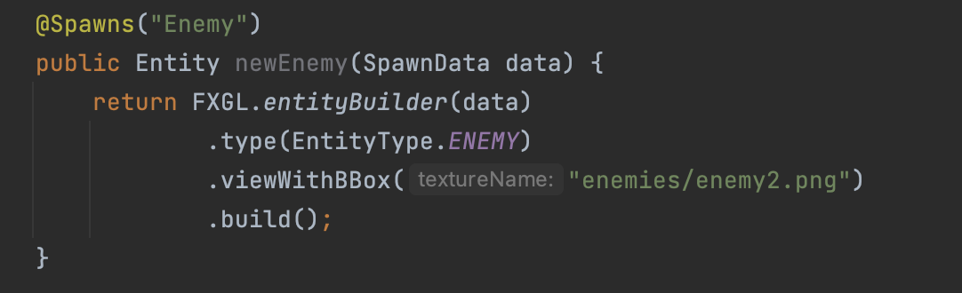
DEFINE an enemy
Make sure images of enemies are placed under the correct folder!
TowerDefenseFactory.java

Slide 13

SPAWN a dummy enemy
TowerDefenseApp.java
Spawning game entities should be done inside function initGame()
Customize the initial location of the enemy

Slide 14
To make towers TURN to enemies
A Tower entity is responsible for this action
Logics should be implemented in TowerComponent.java
Q: during a gameplay, will towers make 1 turn or many turns?
A: Possibly many turns! Because enemies will be moving
Solution: write the logic in function onUpdate(double tpf)

Slide 15
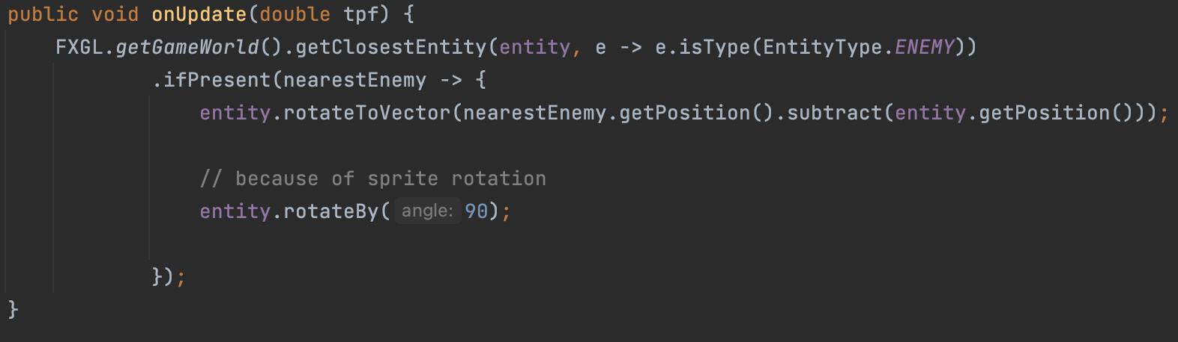
In my gameworld, I want to find a game entity that is of type enemy that is the closest to a tower, if such enemy exists, then rotate the tower to the direction of the enemy

Slide 16
Towers need to shoot bullets
Things to consider
How will the bullet look like?
In which direction will the bullet travel in?
How often should the bullet be fired? Every second? Every 3 seconds?
What happens when bullet hits the enemy?
Solution
Define a bullet in TowerDefenseFactory
Direction of the enemy
Define a timer
Enemy loses health or dies

Slide 17
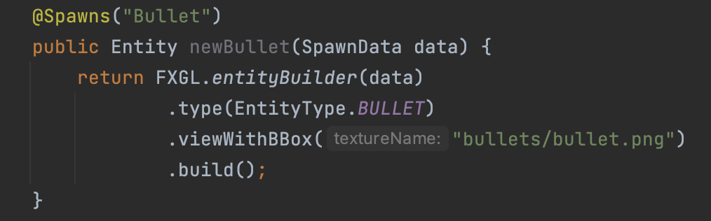
DEFINE a bullet
Make sure images of bullets are placed under the correct folder!
TowerDefenseFactory.java
Need to know which tower the bullet is fired from, which enemy it is trying to hit

Slide 18
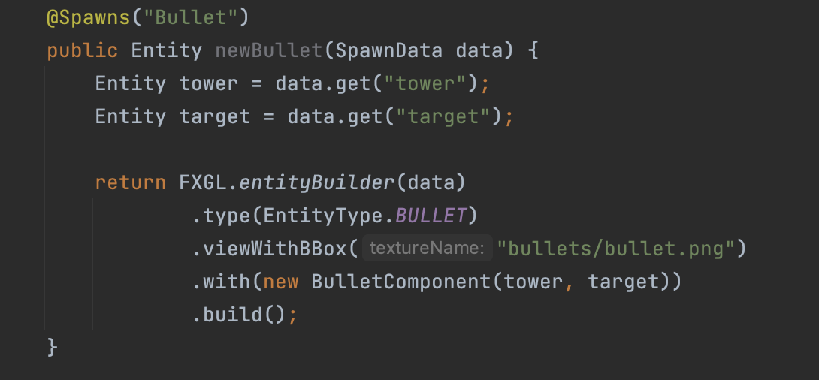
DEFINE a bullet
Need to create BulletComponent.java
TowerDefenseFactory.java

Slide 19
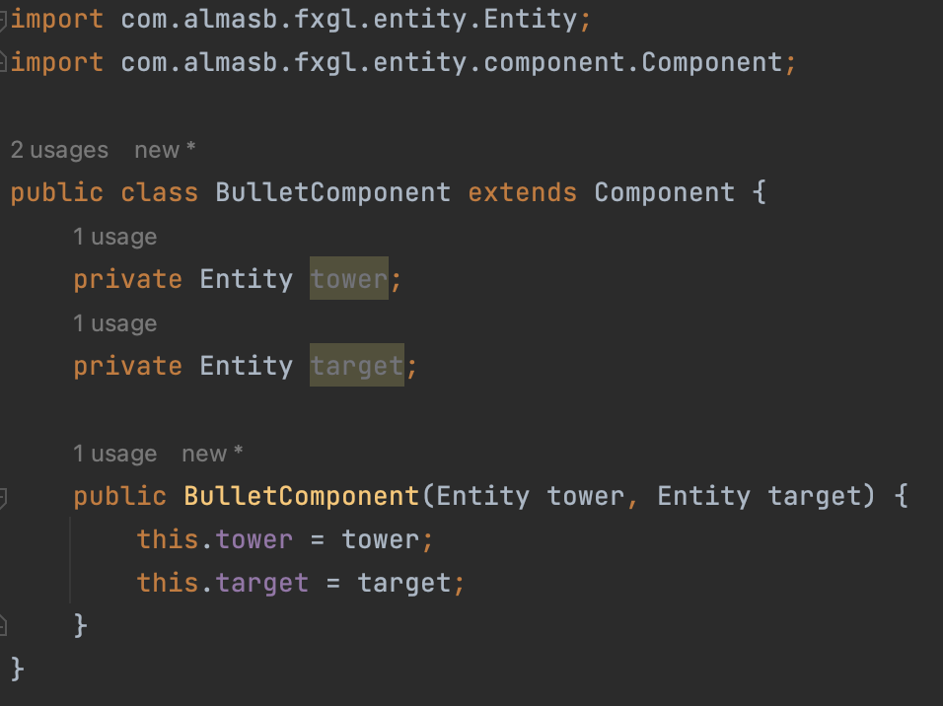
DEFINE a bullet
Check imports!
BulletComponent.java
constructor

Slide 20
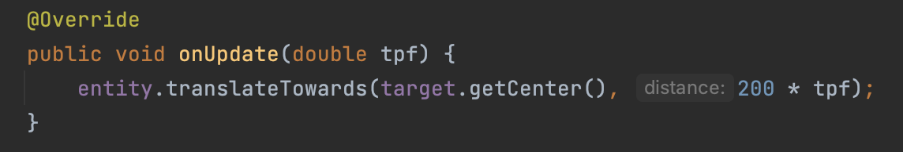
DEFINE a bullet
BulletComponent.java
Bullet always travels to the enemy at some constant speed
ALWAYS => write in function onUpdate(double tpf)

Slide 21
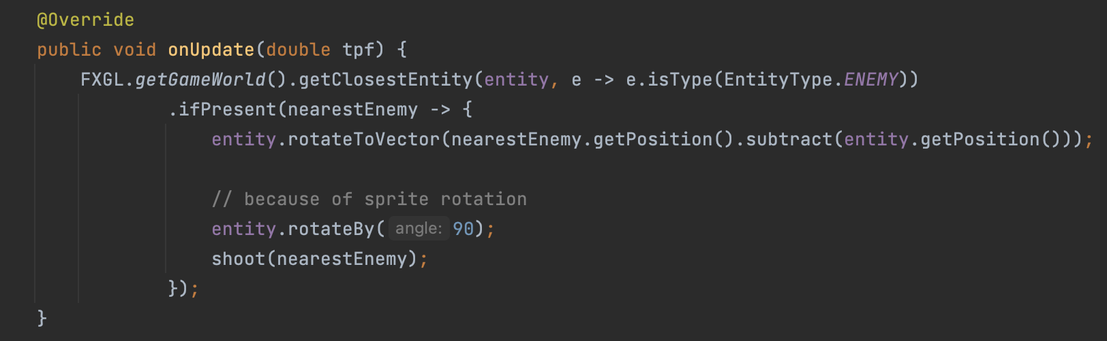
SHOOT the bullet
Tower shoots/spawns a bullet at the nearest enemy

Slide 22
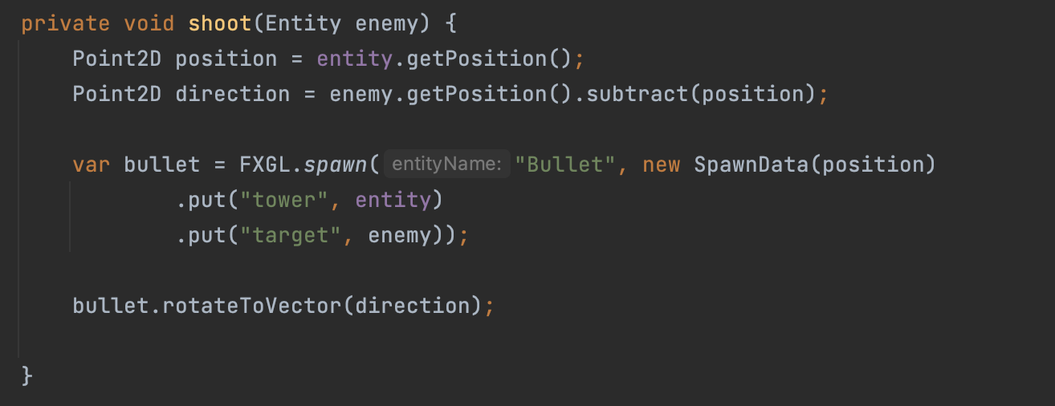
SHOOT the bullet
TowerComponent.java
Tower shoots/spawns a bullet at the nearest enemy

Slide 23
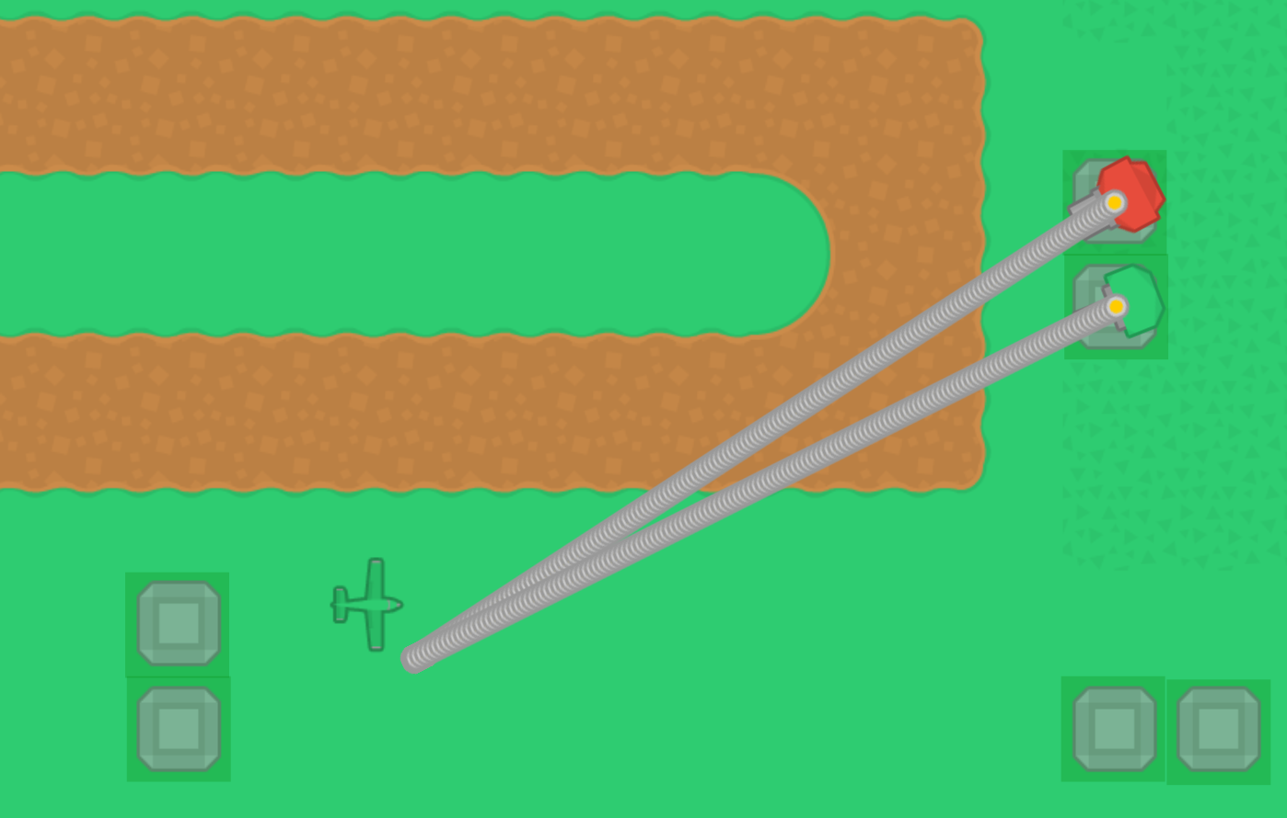
Problem: too many bullet!
Reason: we are creating a new bullet whenever shoot() is called
Calling shoot() is inside onUpdate(double tpf), which means we are creating a new bullet every frame!
Solution: create a shoot timer so bullets are fired periodically

Slide 24
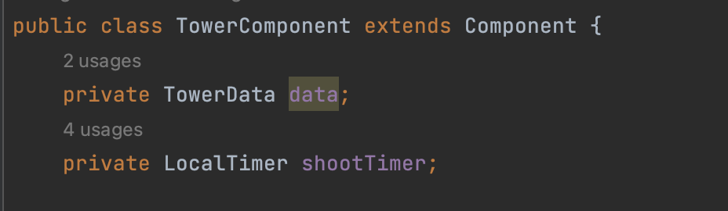
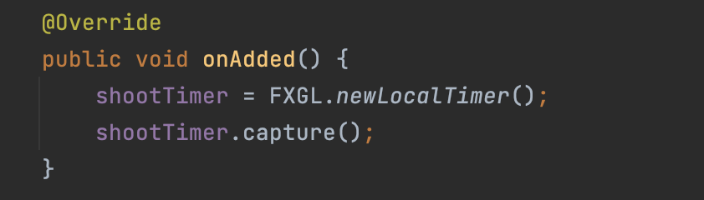

Slide 25
